Slide 1
AVIAN KNOWLEDGE NETWORK Observations Reported to eBird.com at Naval Base Kitsap Bangor
Robert (Robin) Senner
Natural Resources Supervisor, NAVFAC Northwest
29 August 2023
Any views expressed are Dr. Senner’s personal views and not necessarily those of the Department of Defense, Navy, or Federal Government.

Slide 2
How it began….
Principal Investigators (aka lunch break office escapees)
Douglas P. Lister (best birder)
Jason D. McKinney (friendliest birder)
Robert G. G. Senner (most insecure birder)
First lunchtime foray and first eBird checklist: 17 Oct 2016
Hotspots established:
NBK Bangor Upper: Forested upland
NBK Bangor Lower: Hood Canal shoreline and Cattail Creek/Estuary
Trident Lakes: Family recreation area with two ponds and diverse successional stages

Slide 3
Observations at Hotspots
NBK Bangor Upper Hotspot: 17 Oct 2016 – 18 May 2023
123 species
391 checklists
NBK Bangor Lower Hotspot: 28 Oct 2016 – 22 Sep 2022
92 species
36 checklists
Trident Lakes Hotspot: 27 Jun 2010* – 3 Oct 2016 – 19 Aug 2023
83 species
43 checklists
* Single checklist, hotspot established

Slide 4
Species Examples from Hotspots
NBK Bangor Upper Hotspot
Frequent Examples
Dark-eyed Junco
American Robin
Black-capped Chickadee
American Crow
White-crowned Sparrow
NBK Bangor Lower Hotspot
Frequent Examples
Canada Goose
Bufflehead
Common Merganser
Surf Scoter
Glaucous-winged Gull
Trident Lakes Hotspot
Frequent Examples
Pied-billed Grebe (nesting)
Ring-necked Duck
Belted Kingfisher
Bushtit
Barn Swallow
Uncommon Examples
Cassin’s Vireo
Northern Pygmy-Owl
Vaux’s Swift
Western Wood-Pewee
Hammond’s Flycatcher
Uncommon Examples
Warbling Vireo
Willow Flycatcher
Western Tanager
Cliff Swallow
Black Scoter
Uncommon Examples
Red Crossbill
Sharp-shinned Hawk
Townsend’s Warbler
MacGillivray’s Warbler
Evening Grosbeak

Slide 5
Avian Data in INRMPs
Integrated Natural Resources Management Plans INRMPs)
Required by the Sikes Act Improvement Act of 1997 (“Sikes Act,” 16 U.S.C. 670 et seq.)
Prepared and implemented by the installation Natural Resources Managers
Collaborative effort with the statutory partner agencies (USFWS, state fish & wildlife agency, NMFS if marine species/habitats involved)
Metrics prepared and submitted to Sikes Act partner agencies and Navy chain of command annually
Reviewed for operation and effect at least every 5 years
Installations with INRMPs periodically conduct avian surveys
INRMP contents include marine and upland avian survey results and data from the peer-reviewed literature, including ESA-listed species

Slide 6
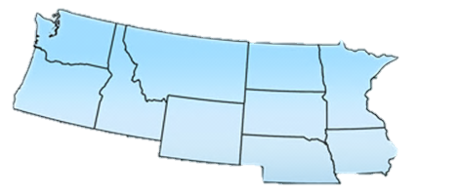
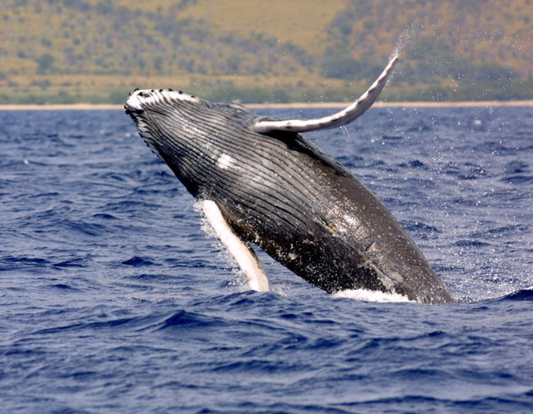
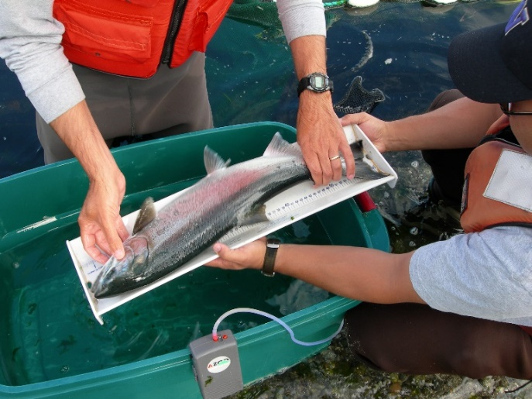
Northwest Natural Resources Program
4 Major Installations
16 Reporting Units
12 INRMPs
6 Natural Resources Managers
Missions Supported
MILCON, NAVAIR, NAVSEA, NAVSUP, NUWC, Range Operations, SIOP, SWFPAC, and Pacific Fleet
66,325 Total Ecosystem Acres*
Terrestrial: 64,912 acres*
Nearshore: 1,413 acres*
22 Federally Listed Species
*Estimated acreage obtained from Navy Conservation website

Slide 7
Navy Region Northwest Installations with INRMPs
NAS Whidbey Island
NAS Whidbey Island *
NWSTF Boardman
NAVMAG Indian Island
NAVMAG Indian Island *
NAVSTA Everett
NAVSTA Everett *
NAVRADSTA Jim Creek
Pacific Beach *
ARD Bayview, ID
NRTF LaMoure, ND
NAVBASE Kitsap
NAVBASE Kitsap Bangor *
NAVBASE Kitsap Bremerton *
NUWC Keyport *
Jackson Park & Naval Hospital
Bremerton RR
Manchester Fuel Department *
Southeast Alaska Acoustic Measurement Facility *
NAVFAC Northwest
Northern Alaska Sites **
* Marbled Murrelet
** Spectacled Eider, Steller’s Eider

Slide 8
AKN as Data Aggregator and Organizer
NAVFAC Northwest’s next step is to collate and analyze avian survey data that has been collected using different media at its installations
Update older data sets
Detect trends in species diversity and geographic distribution
Anticipate and plan for climate-related changes in ESA listings and critical habitat
Coordinate with agency and Tribal data management
Look for potential avian correlations with climate change
Changes in prevailing and recurring weather patterns
Changes in vegetation covertypes and habitat characteristics
Changes in watershed features correlated with precipitation effects
Develop predictive models to inform species and habitat management
Integrate wildland fire management goals and habitat management goals
Inform outreach to stakeholders and educational forums

Slide 9
Questions?
Thank you!

